Slide 1
Disabling Sickness or Condition
TC
10
OPNAV-DSCFRT-2.0
Catalog ID: OPNAV-DSCFRT-2.0 (Updated April 2023)

Slide 2

Agenda
Basic Finance
Consumer Protections
Major Purchases
Planning for the Future
Compensation, Benefits, and Entitlements
Saving and Investing
Caring for Aging Parents
Disabling Sickness or Condition Checklist Available

Slide 3
Basic Finance

Slide 4
Spending Plan
STEP 1: Understand your current situation
  Track inflows and outflows
  Review past financial statements
STEP 2: Know where your money should go
  Save and/or invest 10% – 15%*
  Transportation less than 15% – 20%*
  Limit housing to BAH or 25% or less*
STEP 3: Create a plan
  Prioritize your financial goals
  Build an emergency fund
STEP 4: Make adjustments
  Update with life changes
  Review frequently
STEP 1:
Understand your current
situation
STEP 4:
Make
adjustments
STEP 2:
Know where
your money
should go
4-STEP BUDGETING
PROCESS
  * Pretax income
STEP 3:
Create a plan
Spending Plan Worksheet and Disabling Sickness or Condition Checklist Handout Available

Slide 5

Potential Changes to Income and Expenses
Adjust spending plan to account for possible changes
Changes to income
  Employment status – determine if you and spouse can keep current employment status
  Possibility of continued military service
Changes to expenses
  Additional costs related to caregiving, traveling to and from appointments or therapies
  Housing and transportation needs
  Medical equipment

Slide 6
Understanding Credit
Create healthy habits
  Create a spending plan
  Pay bills on time
  Pay off credit cards monthly
  Only apply if you need credit
  Safeguard information
  Reconcile statements
Credit reputation
  Check your three major credit reports at https://www.annualcreditreport.com/
  Sign up for free credit monitoring
Credit score factors
Types of
Credit
10%
New
Credit
10%
Length of
Credit History
15%
Payment
History
35%
Amounts
Owed
30%
Understanding Credit Handout Available

Slide 7
Taxes and Disability
Tax fundamentals
  Three types of income taxes: federal, state, FICA
  BAH, BAS, pay earned in CZTE areas not taxed
  Benefits related to TSP contributions
Review new tax situation
  Disability payments may or may not be taxed
Potential disability-related tax breaks
  Credit for the elderly or disabled
  Disability-related home improvements
  Child and Dependent Care Credit
Speak with a tax professional

Slide 8
Consumer Protections
Disabling Sickness or Condition Checklist Available

Slide 9
Military Consumer Protections
Know your rights
  Servicemembers Civil Relief Act (SCRA)
  Military Lending Act (MLA)
  Installation legal office
Identity theft protections
  Know the signs of identity theft
  Understand how to protect yourself
  https://www.identitytheft.gov/ or https://consumer.gov/
Military Consumer Protection and Sources for Help for Military Consumers Handouts Available

Slide 10
Misleading Consumer Practices
Recognize scams
  Multilevel marketing / pyramid scheme
  Get rich quick
  Too good to be true
Protect yourself
  Research
  Comparison shop
  Sleep on it
Report a complaint
Sources of Help for Military Consumers Handout Available

Slide 11
Major Purchases
Disabling Sickness or Condition Checklist Available

Slide 12
Housing and Transportation
Make smart purchases
  Logic beats emotion
  Additional costs matter
  Shop around
Housing and transportation
  Modifications needed?
  Long-term care facilities
  Work with base housing
  Analyze transportation needs
  Review your spending plan
  Attend a home buying or car buying class at your local FFSC
Major Purchases and 5 Rules of Buying a House Handouts Available

Slide 13
Education Options
Military education benefits
  Apprenticeship and credentialing programs
  Tuition assistance
  GI Bills (Post-9/11 transfer)
Career and retraining programs
Spouse program – myCAA
Saving for college
  529 College Savings Plan
  Coverdell Education Savings Plan
  Uniform Transfer / Gift to Minors Act (UTMA/UGMA)
Student loan repayment
  Repayment options
  Forgiveness or cancellation options
Education Benefits and Savings and Paying Off Student Loans Handouts Available

Slide 14
Planning for the Future
Disabling Sickness or Condition Checklist Available

Slide 15
Retirement Goals
Military retirement plans
  Legacy
  Blended Retirement System (BRS)
Retirement can be expensive
  Pensions are rare
  Social Security may not be enough
  Health and longevity
  Inflation
Investing can be easy
  Time builds wealth
  Amount contributed
  Potentially greater returns than saving alone
  Compound interest
Thrift Savings Plan
  Manage via TSP website or mobile app
  New features and capabilities
Update beneficiaries
  Retirement accounts – TSP and IRA
  Brokerage and bank accounts
Military Retirement and Thrift Savings Plan Handouts Available

Slide 16
Evaluate LIFE Insurance Needs
Liabilities (debts and obligations)
Income (amount X number of years needed) | +
Final expenses | +
Education and other goals | +
–
Subtract current coverage and assets
Your Total Need
Disabling Sickness or Condition Checklist Available

Slide 17
Life Insurance Overview
Servicemembers’ Group Life Insurance (SGLI)
  Coverage
  Death benefit
  Beneficiaries
Family Servicemembers’ Group Life Insurance (FSGLI)
Veterans’ Group Life Insurance (VGLI)
Private life insurance
  Term and permanent coverage
  War clause and other restrictions
  Beneficiaries
  Premium payments

Slide 18
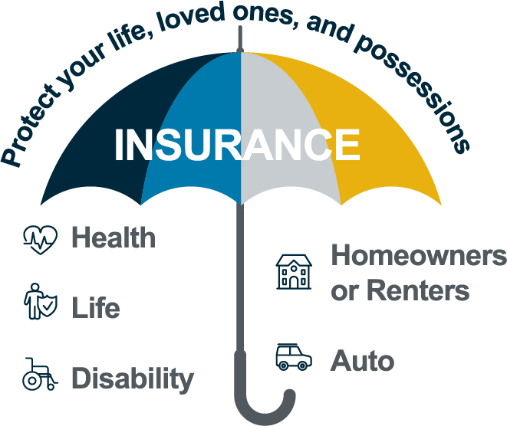
Property and Auto Insurance
Review and update as needed
Property and liability
  Review for adequacy
  Update as needed
Auto
  Update policies
  Inform insurer of updates or modifications to vehicles

Slide 19
Estate Planning
Legal documents
  Will
  Durable and medical powers of attorney (POA)
  Living will (advanced medical directive)
  Letter of instruction
Special needs considerations
  Special needs trust (SNT)
  ABLE account
  Special Care Organizational Records
Family Care Plan
Review / update property documents
  Asset titling for home and autos
Estate Planning and Survivor Benefits Overview Handouts Available

Slide 20
Compensation, Benefits, and Entitlements
Disabling Sickness or Condition Checklist Available

Slide 21
Disability Income
VA Disability
  For Service member being discharged
  Tax-free compensation, based on disability rating
  https://www.va.gov/disability/
Social Security Disability Income (SSDI)
  Anyone with a disability can apply
  Lengthy and complex process
  https://www.ssa.gov/

Slide 22
Health and Dental Coverage
Health insurance
  TRICARE coverage
    Coverage may change for affected family member
    Prime and Select require annual enrollment
  Other medical coverage
    Spouse employer coverage
    VA medical clinics / hospitals
    Medicaid vs. Medicare
Dental coverage
    Premiums and copays required for active-duty families
    Coverage stops when separated
    VA might not cover
    Enrollment required
TRICARE Overview Handout Available

Slide 23
EFMP and ECHO
Exceptional Family Member Program (EFMP) assists families with special needs to include:
  Specialized medical and dental care
Developmental requirements
Special education requirements
Accessibility and / or adaptive equipment
Specific mental health conditions
Enrollment is mandatory
Extended Care Health Option (ECHO)
Provides financial assistance to beneficiaries with special needs
EFMP enrollment required

Slide 24
Survivor Benefits
Death gratuity
Survivor Benefit Plan (SBP)
Dependency and Indemnity Compensation (DIC)
Dependent Educational Assistance (DEA)
Social Security survivor benefits

Slide 25
Saving and Investing
Disabling Sickness or Condition Checklist Available

Slide 26

Emergency Fund Tips
Strive to save and maintain 3-6 months of living expenses
Automate savings
Keep funds accessible
Use for EMERGENCIES ONLY!
Emergency
Not an emergency

Slide 27
Caring for Aging Parents
Disabling Sickness or Condition Checklist Available

Slide 28
Considerations for Parent Care
Housing and care options
  In-home care
  Assisted living / nursing home
  Residing with family
Making them a dependent
  Many forms, long process
  Consult installation legal office
Medical insurance
  Enroll in TRICARE Plus (if a dependent)
  Enroll in Medicare or Medicaid (if eligible)

Slide 29
Summary and Resources

Slide 30
Summary
It’s important to have a plan in place to handle when facing a disabling sickness or condition.
Take an “all hands on deck” approach.
Let’s recap what you learned.
  Basic Finance
  Consumer Protections
  Major Purchases
  Planning for the Future
  Compensation, Benefits, and Entitlements
  Saving and Investing
  Caring for Aging Parents

Slide 31


Resources
Checklist and Handouts
Financial Education and Support
  Command Financial Specialists (CFSs)
  Personal Financial Managers (PFMs)
  Fleet and Family Support Center (FFSC)
  Navy-Marine Corps Relief Society (NMCRS)
  Military OneSource
Financial Literacy Mobile Apps
  MyNavy Financial Literacy
  Sen$e

Slide 32
Thank You!
The appearance of U.S. Department of Defense (DoD) visual information does not imply or constitute DoD endorsement.
Catalog ID: OPNAV-DSCFRT-2.0 (Updated April 2023)

